Slide 1
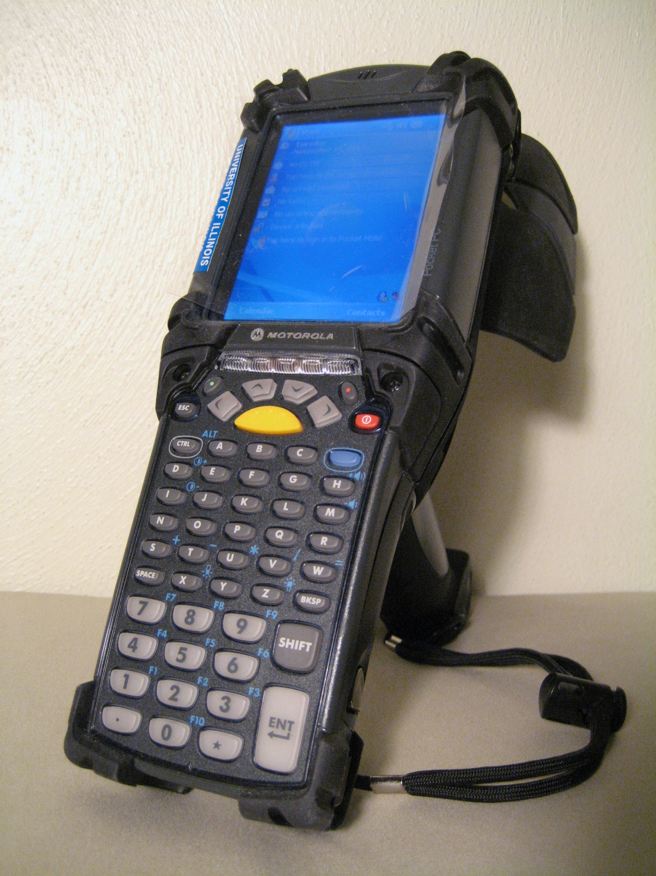
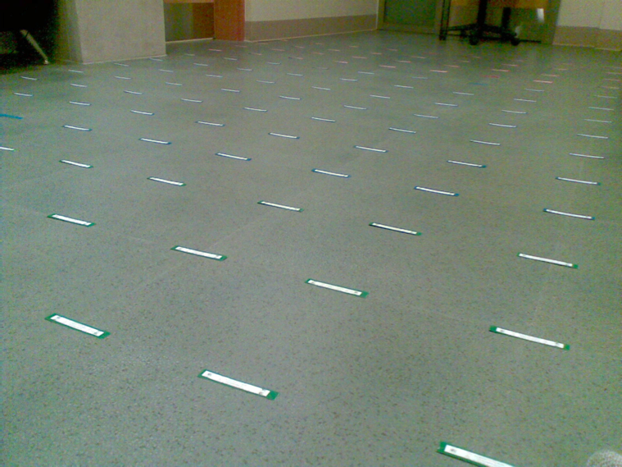

Exploiting Space-time Correlations in an RFID Tag Field for Localization and Tracking
Victor K.Y. Wu and Nitin H. Vaidya
University of Illinois at Urbana-Champaign
Passive RFID Tag Field
Stationary tags distributed densely over large physical area
Tags have storage memory
Tags can fail temporarily (or scans can be inaccurate)
Tags can fail permanently due to environmental conditions such as weather
Tags are cheap, can be replaced
System decays gracefully, according to deployment and maintenance of tags; it is robust
Users move through tag field with RFID interrogators
A user scans a subset of tags in a space-time locality; those tags are space-time correlated
Motorola MC9090-G RFID reader.
Space-time Correlations
Store space-time correlation information in the tags themselves (inline storage)
One scan results in one weighted arrow, which is the result of a correlation function
Possible weightings are “equal”, “number of tags”, and “inverse max entrance time difference”
Possible directions are “oldest to newest” and “oldest to centroid”
RFID tag field.
Experimentation
Walk through a tag grid with an interrogator, scanning tags
Record space-time correlations
Compare the weighted arrows with the original trajectory
Use different metrics depending on the application – localization and tracking; search and rescue
Arrow field with d^{(new)} from one run. Antenna power = P₂.
Arrow field with d^{(cen)} from one run. Antenna power = P₂.
References
D. Hahnel, W. Burgard, D. Fox, K. Fishkin, and M. Philipose, “Mapping and Localization with RFID,” Apr. 2004.
J. Bohn and F. Mattern, “Super-Distributed RFID Tag Infrastructures,” Nov. 2004.
Arrow field with d^{(sar,new)} from one run. Antenna power = P₃.

